Slide 1
Chapter 17
Pricing Objectives and Policies
Notes:
For use only with Perreault/Cannon/McCarthy.
© 2019 McGraw-Hill Companies, Inc.
CHAPTER SEVENTEEN
Lecture Notes for
Essentials of Marketing 16e

Slide 2
At the end of this presentation, you should be able to:
explain the dimensions of price and value.
understand how pricing objectives should guide strategy planning for pricing decisions.
understand choices marketing managers must make about price flexibility.
know what a marketing manager should consider when setting the price level for a product in the early stages of the product life cycle.
understand the many possible variations of a price structure including discounts, allowances, and who pays transportation costs.
Notes:
At the end of this presentation, you should able to:
1. understand how pricing objectives should guide strategy planning for pricing decisions.
2. understand choices marketing managers must make about price flexibility.
3. know what a marketing manager should consider when setting the price level for a product in the early stages of the product life cycle.
4. understand the many possible variations of a price structure including discounts, allowances, and who pays transportation costs.

Slide 3
At the end of this presentation, you should be able to:
understand the value pricing concept and its role in obtaining a competitive advantage by offering target customers superior value.
understand the legality of price level and price flexibility policies.
understand important new terms.
Notes:
At the end of this presentation, you should be able to:
6. understand the value pricing concept and its role in obtaining a competitive advantage by offering target customers superior value.
7. understand the legality of price level and price flexibility policies.
8. understand important new terms.

Slide 4
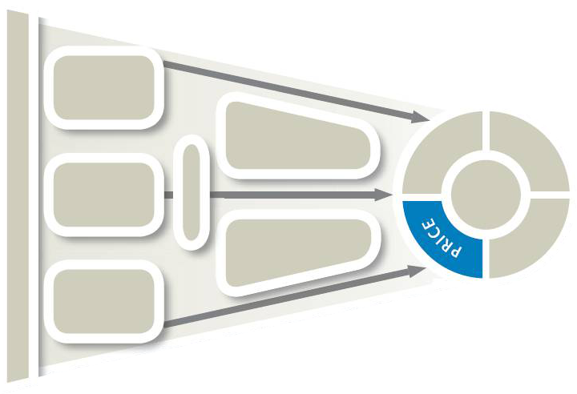
Strategy Planning and Pricing Objectives and Policies
(Exhibit 17-1)
CH 17: Pricing Objectives and Policies
CH 18: Price Setting in the Business World
Pricing objectives
Pricing policies
Pricing and customer value
Legal issues and pricing policies
Notes:
Summary Overview
This chapter will help you better understand pricing objectives and policies that influence how firms make pricing decisions.
Key Issues
Price is what a customer must give up to get the benefits offered by the rest of a firm’s marketing mix, so it plays a direct role in shaping customer value.
Price is one of the four major variables a marketing manager controls.
Price-level decisions are especially important because they affect both the number of sales a firm makes and how much money it earns.
This chapter will discuss “Price” in the following categories:
Pricing objectives
Pricing policies
Pricing and customer value
Legal issues and pricing policies
Chapter 18 will discuss how prices are set.

Slide 5

Starbury
Click on play button to view video
Notes:
Price plays a direct role in shaping customer value. The Starbury line of basketball shoes came at a significantly lower price than most of its competitors. The Starbury line went out of business. This might be an opportunity to talk about the challenges of a low-price brand.
(video length 0:15)
Video Operation:
INTERNET CONNECTION REQUIRED
Clicking on the orange circle image will open a web browser and access this video. When the video is completed, you can close or minimize the browser and return to the PowerPoint slides.

Slide 6
Price Exchanged for Something of Value (As Seen by Consumers or Users)
(Exhibit 17-2)
Price
Something of Value
List Price
Less: Discounts
  Quantity
  Seasonal
  Cash
  Temporary sales
Less: Allowances
  Trade-ins
  Damaged goods
Less: Rebate & coupon
Plus: Transportation and taxes
Product
  Physical good
  Service
  Assurance of quality
  Repair facilities
  Packaging
  Warranty
  Psychic benefit
Place of delivery or when available
Exchange
Notes:
Summary Overview
Price is the amount of money that is charged for “something” of value. The things for which prices are charged range from purely physical products, to products with substantial service components, to pure services. College tuitions, apartment rents, hotel room rates, country club dues, bank interest rates, airline fares, and attorneys’ fees are all examples of price.
Key Issues
This exhibit summarizes some possible variations of price for consumers or users.
On the price side, discounts, allowances, rebates or coupons, transportation, and taxes may alter the list price.
→ The price ultimately paid equals the value component of the “something.”
As shown, this component may be much more than a purely physical good, and may encompass intangible value assessments, such as the assurance of quality.
Discussion Question: Can you provide an example of a product for which you’d gladly pay more because you perceive the quality of the product to be better than the competition?

Slide 7
Price Exchanged for Something of Value (As Seen by Channel Members) (Exhibit 17-3)
Price
Something of Value
List Price
Less: Discounts
  Quantity
  Seasonal
  Cash
  Trade or functional
  Temporary “deals”
Less: Allowances
  Damaged goods
  Advertising
  Push money
  Stocking fees
Plus: Transportation, taxes, tariffs, and costs of handling or disposal
Product
  Branded—well known
  Guaranteed & warranted
  Service/repair facilities
  Convenient packaging
Place
  Availability--when/where
Promotion
  Promotion aimed at end-user customers
Price
  Price-level guarantee
  Sufficient margin & inventory turns to allow for profit
Exchange
Notes:
Summary Overview
This exhibit shows the price equation as seen by channel members.
Key Issues
On the price side, discounts, allowances, transportation, and taxes may alter the list price, although they may operate somewhat differently than in the consumer market.
For example, quantity discounts and trade-in allowances are typically more important to channel members than to final consumers.
→ Again, the price ultimately paid equals the value component of the “something."
As shown, this component may encompass elements of each of the four Ps.
Certain elements of the four Ps have greater or lesser importance to channel members, depending on what the “something” is and how long it will be in the channel.
For example, the expected profit margin on resale is a critical issue for channel members, as is packaging that facilitates shipping and handling farther down the line in the channel.
Discussion Question: When would a channel member be motivated to stock a product that offered a relative low profit margin when resold?

Slide 8
Possible Pricing Objectives (Exhibit 17-4), slide 1 of 3
Target return
Profit oriented
Maximize profits
Pricing objectives
Notes:
Summary Overview
Company-level and marketing objectives provide the guidance for setting pricing objectives. Pricing objectives should be explicitly stated because of their effect on the pricing policies adopted by the company. Pricing policies also affect the marketing mix (product, promotion, place, target customers) as marketing managers use strategy planning to support the information communicated to consumers through the product’s price.
Key Issues
Two types of profit-oriented objectives are common:
Target return objective: sets specific guidelines for a level of profit.
Prices may be linked to a percentage of sales or return on investment. Some companies just want satisfactory profits that ensure the firm’s survival and provide adequate returns to shareholders.
Companies that are industry leaders, as well as public service companies, often pursue satisfactory profits because of the public scrutiny they receive.
→ Profit maximization objective: the firm sets prices to seek as much profit as possible. This objective may be used to recoup high investment costs or it may be simply a matter of company policy.
Profit maximization can be socially responsible, as it does not always lead to high prices. Prices that are initially high during market introduction can go down in the later stages of the product life cycle, thus expanding sales and profits.
Discussion Question: Can you provide examples of products that entered the market at a high price and got progressively less expensive as they matured?

Slide 9
Possible Pricing Objectives (Exhibit 17-4), slide 2 of 3
Target return
Profit oriented
Maximize profits
Dollar or unit sales growth
Pricing objectives
Sales oriented
Growth in market share
Notes:
Summary Overview
With sales-oriented objectives, pricing supports the objective of increasing sales, without regard to their effects on profit.
Key Issues
→ Sales growth doesn’t necessarily mean big profits, because marketers may overlook the costs associated with delivering those sales.
→ Market share growth objectives are popular.
Coupled with a long-run view of the overall market growth rate and attention to costs, this approach can lead to long-term competitive advantages.
Discussion Question: What is the danger of pricing a product too low in an attempt to maintain market share?

Slide 10
Possible Pricing Objectives (Exhibit 17-4), slide 3 of 3
Target return
Profit oriented
Maximize profits
Pricing objectives
Dollar or unit sales growth
Sales oriented
Growth in market share
Meeting competition
Status quo oriented
Nonprice competition
Notes:
Summary Overview
For firms content with the way things are, two status quo objectives are often used. They might be termed “don’t-rock-the-pricing-boat” objectives.
Key Issues
→ Meeting competition stabilizes market prices because no firm benefits from raising or lowering prices.
This objective is often used when the total market for a product is not growing.
→ With nonprice competition, aggressive action is taken in the other three areas of the 4 Ps, staying clear of price as a competitive “battleground.”
Many specialty goods compete using nonprice competition aimed at the consumer who is seeking advantages other than price—such as a prestige image or high quality.
Discussion Question: For some specialty products, there is an old saying, “If you have to ask how much it costs, you can’t afford it.” Can you give examples of these kinds of products? Is price emphasized in their promotion?

Slide 11
Checking Your Knowledge
An industry-leading high-tech company just announced that it was cutting its prices and would price its products at whatever level was necessary to protect its market share. This is evidence of a ____________ pricing objective.
A. target return
B. status quo-oriented
C. profit maximization
D. sales-oriented
E. non-price competition
Notes:
Checking Your Knowledge :
Answer: D
Feedback: A sales-oriented objective seeks some level of unit sales, dollar sales, or share of market—without referring to profit. This example shows evidence of a sales-oriented pricing objective. The best answer selection is D.

Slide 12
Most Firms Set Specific Pricing Policies—To Reach Objectives
One-Price Policy
Flexible Price Policy
The same for everyone
Frequently purchased items
Convenient
Low cost
Maintains goodwill
Different customers, different prices
Databases make it easier
Salespeople can adjust prices
Too much cutting can hurt profits
OR
Notes:
Summary Overview
Price policies usually lead to administered prices—consciously set prices. This practice is difficult with indirect distribution, but administered prices help achieve pricing objectives. One key decision is about price flexibility policies.
Key Issues
One-price policy: the same for everyone.
It is common with frequently purchased, inexpensive items.
It can be more convenient, entail lower transaction costs, and maintain goodwill with customers.
Flexible-price policy: offering different prices for different customers.
Pricing databases make flexible pricing easier, less costly, and less time consuming, because they contain information about different customers.
Dynamic pricing means pricing changes with demand.
Salespeople can also adjust prices to take into account the competition, the firm’s relationship with a customer, and the customer’s bargaining ability. However, too much price-cutting may erode profits (see Exhibit 17-5 in next slide).
A flexible-price policy may prompt resentment by customers who do not get the lowest price.
Channel conflict may also result, or an unauthorized “gray” channel may evolve if customers buy in large quantities, say, to get a price break, and then resell what they don’t need.
Discussion Question: Airlines and auto dealers often use flexible pricing. Is this practice fair to all consumers? Why or why not?

Slide 13
Too Much Price-Cutting Erodes Profits (Exhibit 17-5)
$100 list price
$100
10% price cut
→ new price = $90
Cost per unit = $80
50% profit margin cut
$60
$40
$20
$20
$10
Notes:
Summary Overview
This slide displays the impact of price cutting on profit.
Key Issues
A small price cut may not seem like much, but keep in mind that the revenue lost would have gone to profit.
Let’s take an example of a company selling a product for $100.
→ A 10% price cut reduces the price to $90.
→ In this example, let’s assume the cost per unit is $80. Now the 10% price cut results in a 50% drop in profit margin.
Marketing managers must approach price cutting carefully.
Discussion Question: Under what conditions might a price cut still be a good strategy decision?

Slide 14
Price-Level Policies—Over the Product Life Cycle
Introductory Prices
Key Considerations for Marketing
Managers
Product Life-Cycle
Prices Above, Below, or Relative to the Market
Notes:
Summary Overview
In administering prices over the product life cycle, marketing managers must set price level policies. They must consider where the product life cycle is—and how fast it’s moving. Further, they must decide if their prices should be above, below, or somewhere in-between relative to the market. Price policies have strategy implications that must be supported with appropriate resources.
Key Issues
For a new product with few (or no) direct substitute marketing mixes, price-level decision should focus first on the nature of market demand.
A high price may lead to higher profit from each sale, but also to fewer units sold.
A low price might appeal to more potential customers.

Slide 15
Alternative Introductory Pricing (Exhibit 17-6)
“Skim the Cream” Pricing
Penetration Pricing
Firm tries to sell at a high price before aiming at more price-sensitive consumers
Initial
skimming
price
Firm tries to sell whole market at one low price
Second
price
Initial
skimming
price
Final
price
Quantity
Quantity
Notes:
Summary Overview
Two of the major price-level policies are price skimming and price penetration.
Key Issues
→ The skimming price policy feels out demand at a high price before aiming at more price-sensitive customers.
Skimming may maximize profits in market introduction if there are few substitutes or if customers are not price sensitive.
Skimming has critics, who charge that this policy should not be used for products, such as prescription drugs, that have important social consequences.
On the other hand, the profit generated from this strategy provides the firm with an incentive to pursue other breakthrough opportunities.
→ When well executed, price moves down the demand curve when each price-linked segment is nearly exhausted.
The new price, and new features, should attract a new target market and help maximize profits over the course of the product’s life cycle.
The penetration pricing policy tries to achieve volume at a low price.
A penetration policy typically aims at setting a price low enough to discourage competition.
If successful, large volume may help producers lower costs further, leading to still lower prices.
Discussion Question: How does price sensitivity differ in price skimming compared to price penetration?

Slide 16
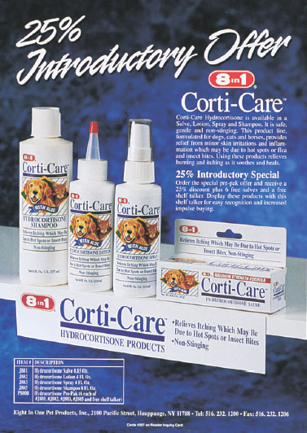
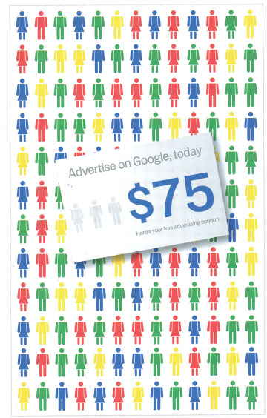
Other Price-Level Policies
Left: Source: Spectrum Brands, Inc.; Right: Source: Google
Notes:
Text Caption: See below.
Summary Overview
Marketing managers have several other options in setting price levels:
Key Issues
Introductory price dealing uses a temporary low price to attract customers to new product launches or new versions of products.
Corti-care and Google ads illustrate that marketers often use introductory price dealing—in the form of temporary price cuts, introductory coupons, or trade-in allowances—to speed new products into a market.
There may be different price-level policies throughout the channel. When selling to members of a channel of distribution, prices must allow for the intermediaries to make a profit.
Discussion Question: If you were an intermediary, how would the prices charged by your suppliers affect your willingness to aggressively market a particular supplier’s product?
The price of money may affect the price level.
As more firms compete internationally, exchange rate changes can have a significant effect on price level policies.
Fluctuations in exchange rates subsequently affect the demand for products in international markets.
Marketers often use introductory price dealing—in the form of temporary price cuts, introductory coupons, or trade-in allowances—to speed new products into a market.

Slide 17
Discount Policies—Reductions from List Prices
Quantity
Seasonal
Discounts
From
List Price
Sale
Cash
Trade
Notes:
Summary Overview
Basic list price: the price final consumers or users are normally asked to pay for products. Discounts are reductions from list price given to buyers who either give up a marketing function or provide it themselves.
Key Issues
Quantity discounts encourage volume buying; the customer pays less per unit.
Cumulative quantity discounts: apply to all purchases in a given period.
Noncumulative discounts: apply only to individual orders.
→ Seasonal discounts encourage buyers to buy sooner.
Manufacturers use this policy to help shift the storing function down the channel and to stabilize demand.
→ Cash discounts are reductions in the net—the face value of the invoice due immediately—to encourage buyers to pay quickly.
2/10 net 30: 2% off the price if the invoice is paid in 10 days, with the net due within 30 days, and an additional interest charge after 30 days.
Discussion Question: A 2% discount doesn’t sound like much. Why are cash discounts given and why should buyers evaluate them?
Consumers say “charge it.” Retailers that accept credit cards pay a percent of the revenue from each credit sale for the service.
This raises some ethical concerns: Are banks making credit too easy, helping trap low-income consumers in debt?
→ Trade discounts: reductions in list price given to channel members that perform one or more marketing functions for the producer.
→ Sale prices reduce list prices temporarily to encourage immediate buying. Frequent price-dropping can condition buyers and sellers to shop for sales and may erode brand loyalty.
Everyday low pricing: using low list prices rather than relying on frequent sales, discounts, or allowances.

Slide 18
Allowance Policies—Off List Prices
Advertising
Stocking
Common
Types of
Allowances
Trade-Ins
Push Money
Notes:
Summary Overview
Allowances are given to channel members or final consumers for doing something or accepting less of something.
Key Issues
Advertising allowances exchange something for something else: price reductions given to firms in the channel to promote the supplier’s products locally.
→ Stocking allowances: Also called slotting allowances, these are given to intermediaries to get attention and shelf space for a product.
Stocking allowances are used mainly in supermarkets, where space is at a premium, forcing producers to pay for product placement.
Are stocking allowances unethical?
Some producers think so, calling them a form of extortion.
Small producers think that stocking allowances put them at a real disadvantage compared to larger producers with more resources.
Retailers, on the other hand, call stocking allowances an insurance against product failures. Producers must produce better products that consumers really want in order to secure shelf space.
Discussion Question: Do stocking allowances harm consumers?
→ Manufacturers or wholesalers give push money allowances to retailers to be used as incentives for their salesclerks to aggressively push the targeted items.
→ Trade-in allowances: the customer receives a price reduction for used products when similar new products are bought.

Slide 19
Checking Your Knowledge
A construction company is considering purchasing a new crane from a distributor of such equipment. The distributor offers to provide the construction company with a few thousand dollars worth of credit on an old crane that the company would like to replace. This credit offered by the distributor is a:
trade-in allowance.
sale price.
seasonal discount.
trade discount.
cash discount.
Notes:
Checking Your Knowledge
Answer: A
Feedback: A trade-in allowance is a price reduction given for used products when similar new products are bought. The credit offered to the construction company is considered a trade-in allowance. The best answer selection is A.

Slide 20
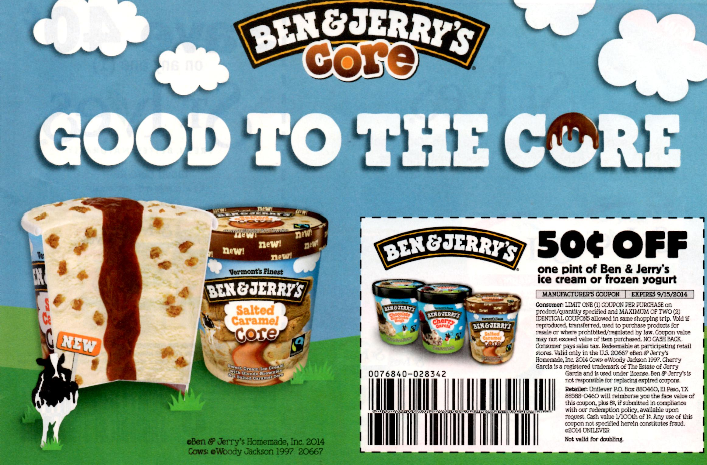
Some Customers Get Something Extra
Source: Ben & Jerry’s
Notes:
Text Caption: Coupons are often used to encourage customers to try a new brand or to attract customers who might not purchase without a discount.
Summary Overview
Consumers using coupons and rebates can receive other reductions in price.
Key Issues
Coupons are printed vouchers that entitle buyers to a price reduction at checkout.
In clipping coupons, consumers get more for less.
Retailers accept coupons because they tend to increase sales volume at no additional promotion expense to the retailer, and retailers are typically paid for the trouble of handling the coupons.
Many firms offer discounts through coupons.
Rebates are refunds given consumers after a purchase. These ensure that the final consumer actually receives the price reduction.
Coupons, deals, and rebates can segment the market
Discussion Question: How does a manufacturer’s rebate on a new car provide more flexibility for the seller’s marketing of the vehicle? How does it provide flexibility for the buyer?

Slide 21
List Price May Depend on Geographic Pricing Policies
F.O.B.
Zone
Common
Geographic
Policies
Freight Absorption
Uniform Delivered
Notes:
Summary Overview
Retail prices sometimes vary according to the location of the buyer relative to the seller. For many industries, geographic pricing policies are an important component of the price variable in the marketing mix.
Key Issues
F.O.B.: Free on board.
The seller pays to have the product loaded on a transportation vehicle at which time the title is transferred to the buyer, who pays shipping and is responsible for the product at that point.
F.O.B. pricing is easy for the seller but may limit the range of the market.
→ Zone pricing smoothes delivered prices by applying an average freight charge to all customers in the same specified geographic area.
This simplifies billing and helps buyers know the delivery charges in advance.
→ Uniform delivered pricing charges one price to all buyers.
In effect, all buyers are in the same “zone,” helping to open large-area markets.
Discussion Question: In the catalog business, uniform delivered pricing is used as a competitive tool. If all buyers pay the same delivery charge, and it also does not vary by order size, what might the effect be on order size?
→ Freight absorption pricing: the company pays the cost of shipping without changing the price in order to get the sale.
Freight absorption helps a distant company to compete on equal grounds in another territory.

Slide 22
Checking Your Knowledge
Janet Eckerd wants to buy a new Volvo. She lives in Richmond, Virginia, but can’t find the exact color and model she wants at her local Volvo dealers. She searches the Web and discovers that a dealership 90 minutes away, in Alexandria, Virginia, has the car she wants. She calls the dealer and finds that the price of the vehicle is the same as it would be in Richmond, although the Alexandria dealer wants to charge Janet an additional $150 to have someone drive the car from Alexandria to Janet’s home in Richmond. As Janet was about to reject the offer and hang up the phone, the dealer offered to waive the extra “shipping charge” and make the price exactly equal to the price in Richmond. This geographic pricing tactic by the Alexandria dealer is a form of:
A. F.O.B. pricing.
B. zone pricing.
C. uniform delivered pricing.
D. intermediary pricing.
E. freight absorption pricing.
Notes:
Checking Your Knowledge
Answer: E
Feedback: With freight-absorption pricing, the firm absorbs the freight cost so that a firm’s delivered price meets the nearest competitor’s price. In this example, the geographic pricing policy used is the freight-absorption pricing. The best answer selection is E.

Slide 23
Valpak
Click on play button to view video
Notes:
This clip highlights Valpak.
(video length 0:30)
Video Operation:
INTERNET CONNECTION REQUIRED
Clicking on the orange circle image will open a web browser and access this video. When the video is completed, you can close or minimize the browser and return to the PowerPoint slides.

Slide 24
Checking Your Knowledge
The simplest geographic pricing policy for a seller to administer is:
A. uniform delivered pricing.
B. F.O.B. pricing.
C. zone pricing.
D. freight absorption pricing.
E. life cycle pricing.
Notes:
Checking Your Knowledge
Answer: A
Feedback: Uniform delivered pricing can be considered the simplest geographic pricing policy because it applies the same (average) freight charge to all buyers. The best answer selection is A.

Slide 25
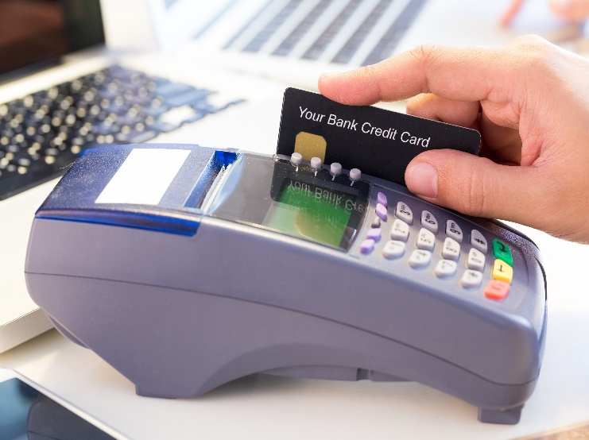
Pricing Policies Combine to Impact Customer Value
Look at Customer’s Viewpoint
Value Pricing = Customer Value
©tuthelens/123RF
Define Target Market and Competition
Value Pricing Fits with Market-Oriented Strategy
Notes:
Summary Overview
Many of the traditional views of pricing emphasize the perspective of the marketing manager. → However, it’s also important to look at price from the customer’s viewpoint.
Key Issues
→ Value pricing: setting a fair price level for a marketing mix that really gives the target market superior customer value.
There are price choices in most markets.
The focus of value pricing is on the customer’s requirements—and how the whole marketing mix meets those needs.
Value pricers try to give the customer pleasant surprises because they increase value and build customer loyalty.
Discussion Question: Can you provide examples of receiving these pleasant surprises from a firm, thus increasing the value of the firm and its products in your eyes?
→ Value pricers define the target market and the competition.
For example, people may want low prices or exceptional personal service.
The market structure and dynamics mean that meeting competitors’ prices may be necessary—especially in an oligopoly, where there may be little choice. In addition differentiation may be necessary.
→ Value pricing fits with strategy planning.
It expands the definition of price beyond money and links it with customer-oriented value. That way the desired value is what is actually received.

Slide 26
Legality of Pricing Policies
Unfair Trade Practice Acts
Dumping
Key
Issues
Price Fixing
Phony List Prices
Notes:
Summary Overview
Some pricing decisions are limited by government legislation.
Key Issues
Minimum prices are sometimes controlled.
Unfair trade practice acts: put a lower limit on prices, especially at the wholesale and retail levels.
These acts protect the viability of certain types of intermediaries, and indirectly benefit the consumer by providing more choices.
→ Dumping is pricing a product sold in a foreign market below the cost of producing it in its domestic market.
Antidumping laws protect domestic producers from foreign competition.
Regulators can set prices.
→ You can’t lie about prices. Phony list prices: prices shown to consumers to suggest that the price has been discounted from list.
In the United States, the Federal Trade Commission (FTC) tries to stop this practice, using the Wheeler-Lea Amendment, which bans “unfair or deceptive acts in commerce.”
Discussion Question: Why do phony list prices still exist, if they are illegal?
→ Price fixing: competitors getting together to raise, lower, or stabilize prices. It is considered conspiracy under the FTC Act and the Sherman Act. Price fixing is illegal—you could go to jail!
Producers may set minimum retail prices. Manufacturers usually suggest a retail list price and leave it up to the retailers to decide what to charge in local markets.

Slide 27
Price Discrimination
Robinson-Patman Act
“Like Grade & Quality”
Key
Issues
“Proportionately Equal” Basis
Cost Differences
Meeting Competition
Notes:
Summary Overview
Price level and price flexibility policies can lead to price discrimination.
Key Issues
U.S. antimonopoly laws, such as the Robinson-Patman Act, ban price discrimination—selling the same products to different buyers at different prices--IF it injures competition. Differences in price have to be based on cost differences or the need to meet competition.
→ Robinson-Patman permits charging different prices for similar products if they are not of “like grade and quality.” But what does this mean? The FTC says that if the physical characteristics of products are similar, then they are of like grade and quality. Therefore, producers wanting to sell several brands at different prices should probably build in physical or other differences that are really useful.
→ Robinson-Patman allows some price differences based on cost, such as quantity discounts. Can cost analysis justify price differences? Yes, but the justification must be developed before setting different prices.
→ Can a seller legally meet price cuts made by a competitor? Yes, if it is done in good faith.
→ If allowances and special promotion aids are not made available to all customers on proportionately equal terms, these special promotions might not be allowed.
Discussion Question: What could happen if this rule did not exist?
How can marketers avoid discriminating illegally? The best advice is to be on sound legal footing through consultation with an attorney.

Slide 28
Key Terms
price
target return objective
profit maximization objective
sales-oriented objective
status quo objectives
nonprice competition
administered prices
one-price policy
flexible-price policy
dynamic pricing
skimming price policy
penetration pricing policy
introductory price dealing
basic list prices
…..
Notes:
Summary Overview
These are key terms you should be familiar with based upon the material in this presentation.
Key Issues
Price: the amount of money that is charged for "something" of value.
Target return objective: a specific level of profit as an objective.
Profit maximization objective: an objective to get as much profit as possible.
Sales‑oriented objective: an objective to get some level of unit sales, dollar sales, or share of market‑‑without referring to profit.
Status quo objectives: "don't-rock-the-pricing-boat" objectives,
Nonprice competition: aggressive action on one or more of the Ps other than Price.
Administered prices: consciously set prices aimed at reaching the firm's objectives.
One‑price policy: offering the same price to all customers who purchase products under essentially the same conditions and in the same quantities.
Flexible‑price policy: offering the same product and quantities to different customers at different prices.
Dynamic pricing: pricing products at a particular customer’s perceived ability to pay.
Skimming price policy: trying to sell the top of the market—the top of the demand curve—at a high price before aiming at more price-sensitive customers.
Penetration pricing policy: trying to sell the whole market at one low price.
Introductory price dealing: temporary price cuts to speed new products into a market.
Basic list prices: the prices that final customers or users are normally asked to pay for products.

Slide 29
Key Terms
discounts
quantity discounts
cumulative quantity discounts
noncumulative quantity discounts
seasonal discount
net
cash discount
2/10, net 30
trade (functional) discount
sale price
everyday low pricing
allowances
advertising allowances
stocking allowances
push money (or prize money) allowances
trade-in allowance
…..
Notes:
Summary Overview
These are additional key terms.
Key Issues
Discounts: reductions from list price given by a seller to buyers, who either give up some marketing function or provide the function themselves.
Quantity discounts: discounts offered to encourage customers to buy in larger amounts.
Cumulative quantity discounts: reductions in price for larger purchases over a given period, such as a year.
Noncumulative quantity discounts: reductions in price when a customer purchases a larger quantity on an individual order.
Seasonal discounts: discounts offered to encourage buyers to buy earlier than present demand requires.
Net: an invoice term meaning that payment for the face value of the invoice is due immediately--also see cash discounts.
Cash discounts: reductions in the price to encourage buyers to pay their bills quickly.
2/10, net 30: allows a 2 percent discount off the face value of the invoice if the invoice is paid within 10 days.
Trade (functional) discount: a list price reduction given to channel members for the job they are going to do
Sale price: a temporary discount from the list price.
Everyday low pricing: setting a low list price rather than relying on frequent sales, discounts or allowances.
Allowances: reductions in price given to final consumers, customers, or channel members for doing something or accepting less of something.
Advertising allowances: price reductions to firms in the channel to encourage them to advertise or otherwise promote the firm's products locally.
Stocking allowances: allowances given to intermediaries to get shelf space for a product—sometimes called slotting allowances.
Push money (or prize money) allowances: allowances (sometimes called PMs or spiffs) given to retailers by manufacturers or wholesalers to pass on to the retailers' salesclerks for aggressively selling certain items.
Trade‑in allowance: a price reduction given for used products when similar new products are bought.

Slide 30
Key Terms
rebates
F.O.B.
zone pricing
uniform delivered pricing
freight-absorption pricing
value pricing
unfair trade practice acts
dumping
phony list prices
Wheeler Lea Amendment
price fixing
Robinson-Patman Act
price discrimination
Notes:
Summary Overview
These are additional key terms.
Key Issues
Rebates: refunds to consumers after a purchase.
F.O.B.: a transportation term meaning free on board some vehicle at some point.
Zone pricing: making an average freight charge to all buyers within specific geographic areas.
Uniform delivered pricing: making an average freight charge to all buyers.
Freight-absorption pricing: absorbing freight cost so that a firm's delivered price meets the nearest competitor's.
Value pricing: setting a fair price level for a marketing mix that really gives the target market superior customer value.
Unfair trade practice acts: puts a lower limit on prices, especially at the wholesale and retail levels.
Dumping: pricing a product sold in a foreign market below the cost of producing it or at a price lower than in its domestic market.
Phony list prices: misleading prices that customers are shown to suggest that the price they are to pay has been discounted from list.
Wheeler Lea Amendment: law that bans unfair or deceptive acts in commerce.
Price fixing: competitors illegally getting together to raise, lower, or stabilize prices.
Robinson‑Patman Act: a 1936 law that makes illegal any price discrimination if it injures competition.
Price discrimination: injuring competition by selling the same products to different buyers at different prices.

